Slide 1
Epidemics on Polluted Networks and $m$-State Networks
Rinni Bhansali
Mentor: Prof. Laura Schaposnik
8th Annual PRIMES Conference
May 2018

Slide 2
An Introduction to Epidemics’ Modeling
History
Kermack-McKendrick SIR Model (1927)
S: Susceptible to infection by the pathogen
I: Infected by the pathogen
R: Individuals removed from the disease network
Dead
Infected and now immune
Vaccinated
A simple and effective model for infectious diseases such as measles
Relies on homogenous mixing
Graph Models
Each vertex denotes an individual (infected, immune, or susceptible to infection)
Edges denote social connections, or possible paths of infection

Slide 3
An Introduction to Epidemics’ Modeling
r-neighbor Bootstrap Percolation (Bollobas)
Initially, each vertex is in an infected state with probability p, or uninfected with probability 1-p
Once infected a vertex is infected forever
Subsequently, uninfected vertices become infected if they have at least r infected neighbors
Percolation: The entire graph is infected at the final state

Slide 4
An Introduction to Epidemics’ Modeling
r-neighbor Bootstrap Percolation
20x20 graph, p = 0.12
200x200 graph, p = 0.12

Slide 5
Epidemics on Polluted Networks
Why Polluted Networks? (Gravner and McDonald)
In the event of a major outbreak, vaccine supplies will likely be insufficient
Optimal methods of vaccine distribution must be discovered
Save the population; maximize herd immunity
Save the “queen”; immunocompromised individuals
The pollution of the graph serves as a representation of vaccinations and vertices are initially
Vaccinated with probability q
Unvaccinated and infected with probability p
Unvaccinated and uninfected with probability 1-p-q

Slide 6
Epidemics on Polluted Networks
Critical Droplet
Critical Droplet: a subset of a graph such that once it is completely infected, percolation of the entire graph becomes highly likely.
Goal: prevent the formation of critical droplets.

Slide 7
Epidemics on Polluted Networks
Vaccination Types
Regular
Random
Center
Everywhere
Lattice
Everywhere
Boundary

Slide 8
Epidemics on Polluted Networks
Efficiency Measures
Efficiency measured by $p_{c}$, the value of $p$ at which the final density of infection is 0.5 on average, given a fixed probability of vaccination $q=0.0512$
In order of increasing efficiency: Center, Boundary, Random, Lattice

Slide 9
Epidemics on m-State Networks
Defining m-State Networks
In a $m$-state network, vertices are initially
Assigned a state from 1 to m with probability $\frac{1}{m}$
Infected with probability p
An uninfected vertex is infected if:
It has an infected neighbor of every state

Slide 10
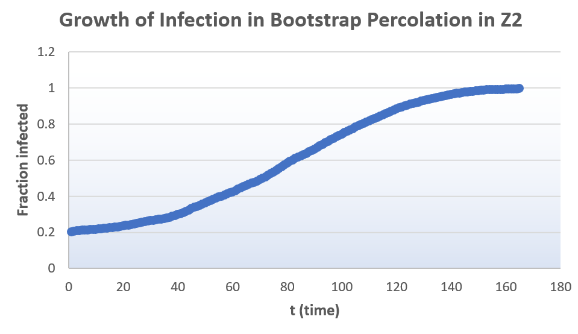
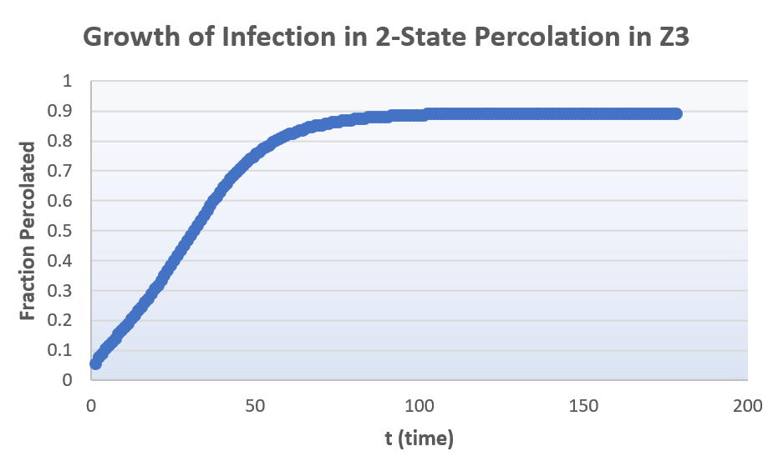
Epidemics on m-State Networks Understanding Percolation
Example: 100x100 graph, $p=0.3$, 2-state
Growth of infections

Slide 11
Slowing Epidemics
Time of Percolation
Goal: slow down percolation
$p_{s}$ = the $p$ at which $t$ is maximal
$p_{s}$ is close to $p_{c}$ (p at which density of infection is 0.5)

Slide 12
Epidemics on m-State Networks Future Work
Identify the critical droplet for 2-state percolation on $ℤ^{3}$
Study minimum percolating sets
Investigate the relationship between $m$ and${ p}_{c},p_{s}$
Different graph structures
Power law degree distribution

Slide 13
Acknowledgements
Prof. Laura Schaposnik
My parents
MIT Math Department
MIT-PRIMES Program
Main Bibliography by: Bollobas, Gravner, Holroyd

Slide 14
Thank you!

